Slide 1
Finki - NeRF Overview
An Introduction to Neural Radiance Fields
By Bojan Ivanovski 225014

Slide 2
Introduction
Finki – NeRF is an implementation of Neural Radiance Fields (NeRF) developed for the course Advanced Web Design at FINKI (Faculty of Computer Science and Engineering), following the original NeRF paper specifications.
Currently only implemented to work with the Synthetic Dataset.

Slide 3

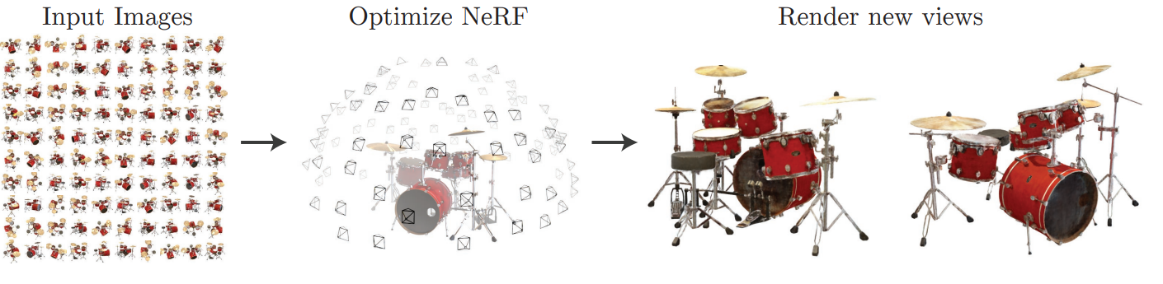
NeRF Fundamentals
Neural Radiance Fields (NeRF) enable synthesizing novel 3D views from 2D images using a continuous volumetric function mapping 3D coordinates to color and density.

Slide 4
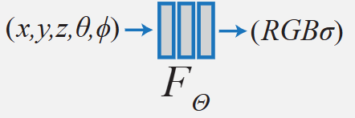
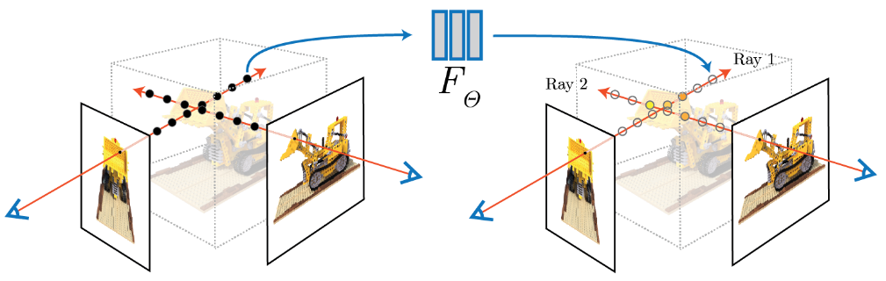
NeRF Concept and Purpose
NeRF uses posed images to generate novel views by modeling scenes as volume densities and colors, enabling 3D reconstruction and AR/VR applications.

Slide 5
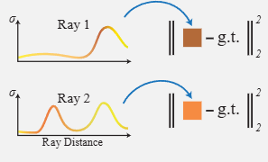
Core NeRF Components and Pipeline
The pipeline combines volume rendering with neural networks using hierarchical sampling for high-quality novel view synthesis from unseen angles. NeRF applies 64 uniform coarse samples per ray and refines predictions with 128 importance samples, integrating colors and densities for detailed novel view synthesis.

Slide 6

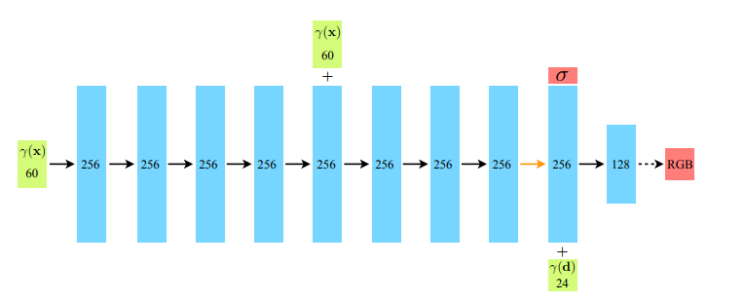
Model Architecture
Dual-Network Structure
Coarse Network
8 fully-connected layers (256 neurons each)
Produces initial density + color estimates
Guides where the fine network should focus
Fine Network
8 fully-connected layers (256 neurons each)
Additional 4 layers (128 neurons each)
Refines predictions using importance sampling for better results

Slide 7

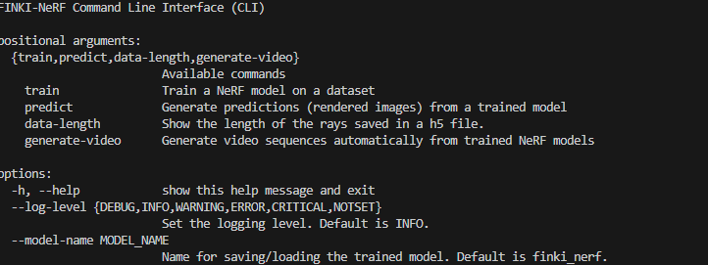
Implementation and CLI Features
FINKI-NeRF provides a full NeRF pipeline with coarse and fine networks, offering CLI commands for training, prediction, and dataset inspection focused on usability and extensibility.

Slide 8
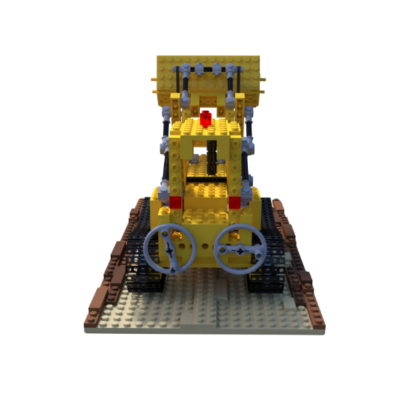
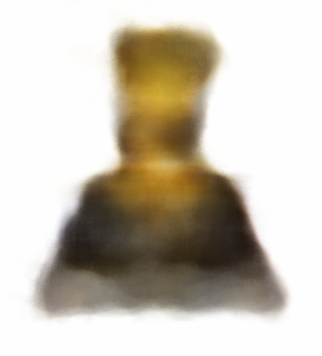
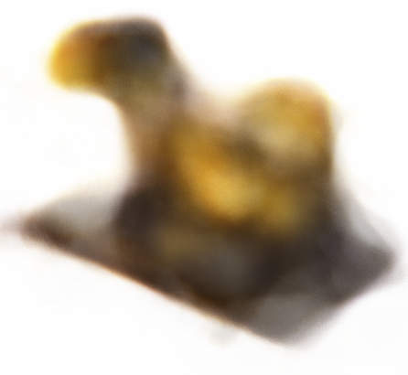

Finki – NeRF Results

Slide 9
Thanks
Do you have any questions?
By Bojan Ivanovski 225014

